Slide 1


Minimum Viable Skillset profiles
Dominique Green
WP2 Leader
Digital Curation Centre
(with thanks to Angus Whyte, DCC & Sara Di Giorgio, GARR)

Slide 2
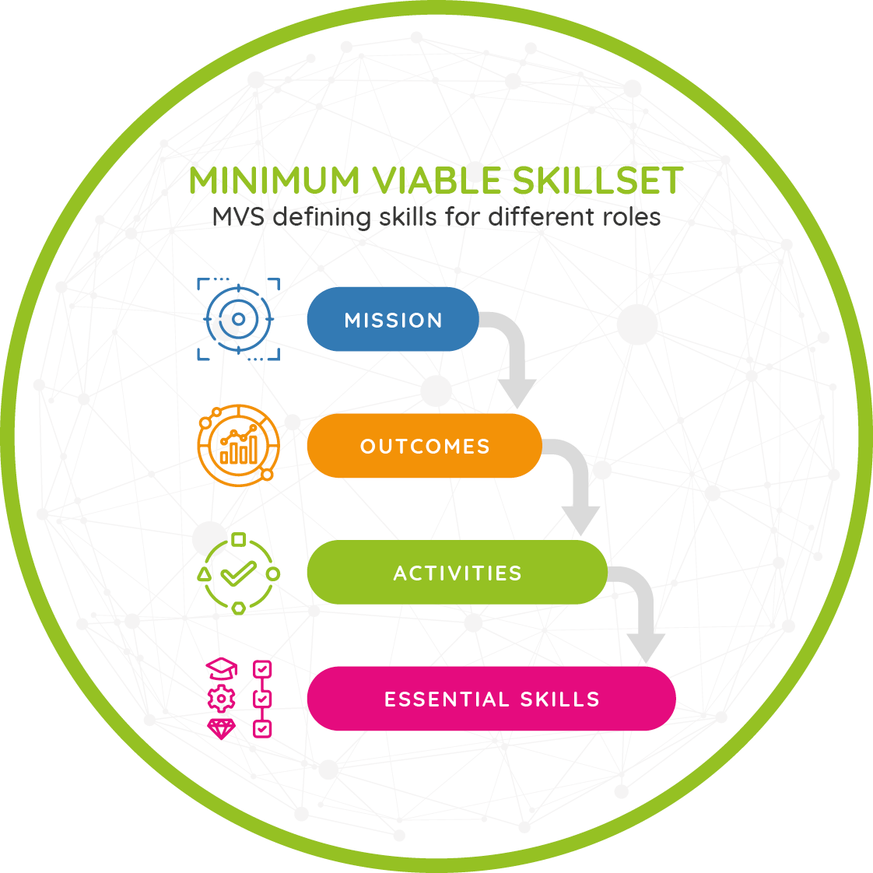
The Minimum Viable Skillset profiles
Summarise OS essentials based on review of competence frameworks and skills resources.
Profile the skills needed for EOSC actor roles, considering the OS mission, outcomes, activities they are expected to contribute to.
Compatible with skills ontologies: ESCO, terms4FAIRskills, & European Competence Framework for Researchers (ResearchComp).
Whyte, A., et al. (2023). D2.1 Catalogue of Open Science Career Profiles - Minimum Viable Skillsets (v1.2). Zenodo. https://doi.org/10.5281/zenodo.8101903

Slide 3
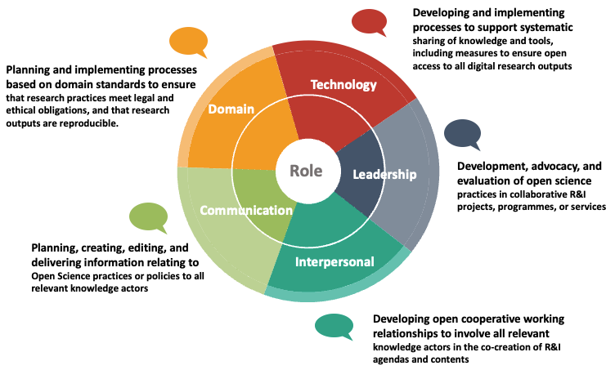
Dimensions of the Open Science Mission
Shading shows extent to which a role covers 5 dimensions described in Horizon Europe Programme Guide

Slide 4
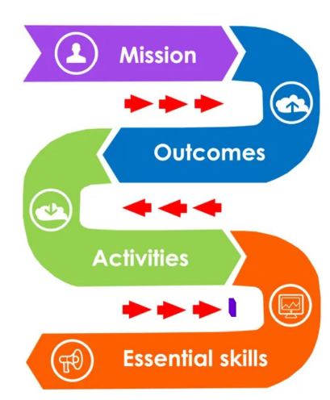
Minimum Viable Skillset - MVS
Provide high level guidance to inform curricula, learning paths, materials.
Adaptable to organisational & domain contexts.
Whyte, A., et al. (2023). D2.1 Catalogue of Open Science Career Profiles - Minimum Viable Skillsets (v1.2). Zenodo. https://doi.org/10.5281/zenodo.8101903

Slide 5

MVS Describe Diverse Roles
In progress
Scholarly Communications Specialist
Digital Collections Curator
Available *
Data Steward
Legal Expert
Ethics Advisor
Knowledge Broker
Masters Student
Undergrad Student
Senior Researcher
Early Career Researcher
Policymaker – Research/ General
Research Infrastructure Professional
Considering
Data Analyst
Data Scientist
Data Engineer
Research Manager
Research Software Engineer
Digital Preservation Specialist
* Currently published MVS are here: https://zenodo.org/records/8101903
Main ref: report Digital skills for FAIR and Open Science

Slide 6
MVS Template
Template for a Minimum Viable Skillset, April 2024, DOI https://zenodo.org/records/10977747
This template provides guidance on structuring a Minimum Viable Skillset (MVS) Profile, outlining key skills and competencies essential for practicing Open Science (OS).

Slide 7
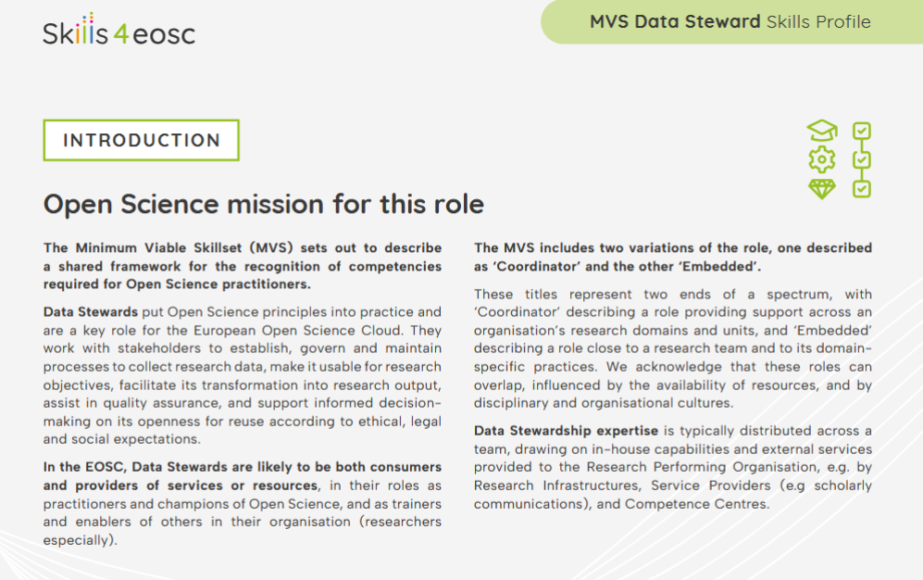
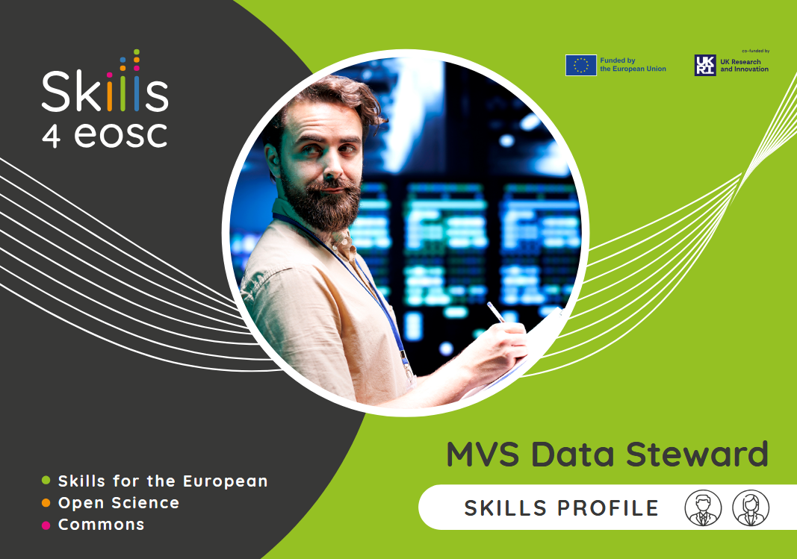
Example: MVS Data Steward

Slide 8
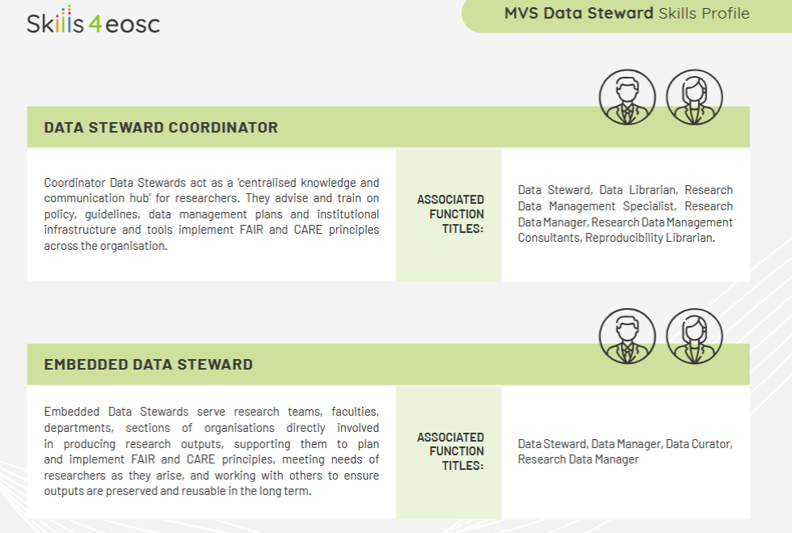

Slide 9
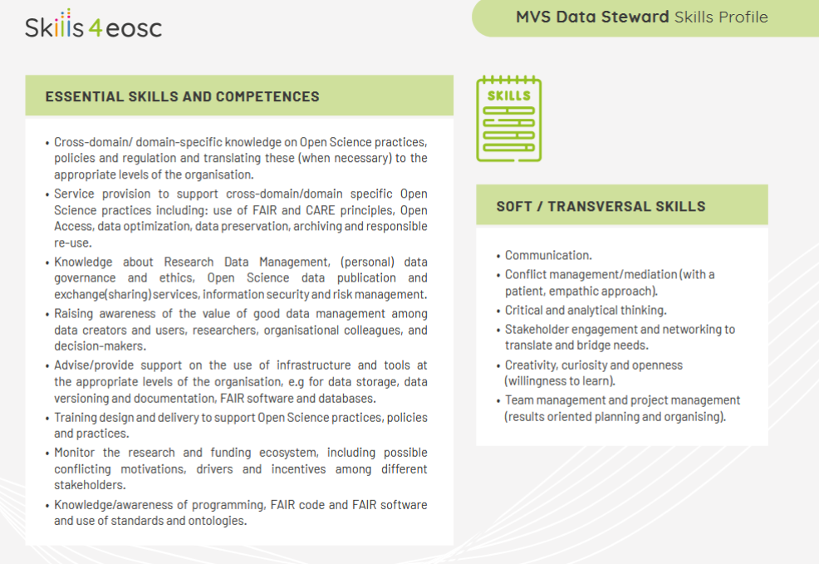

Slide 10
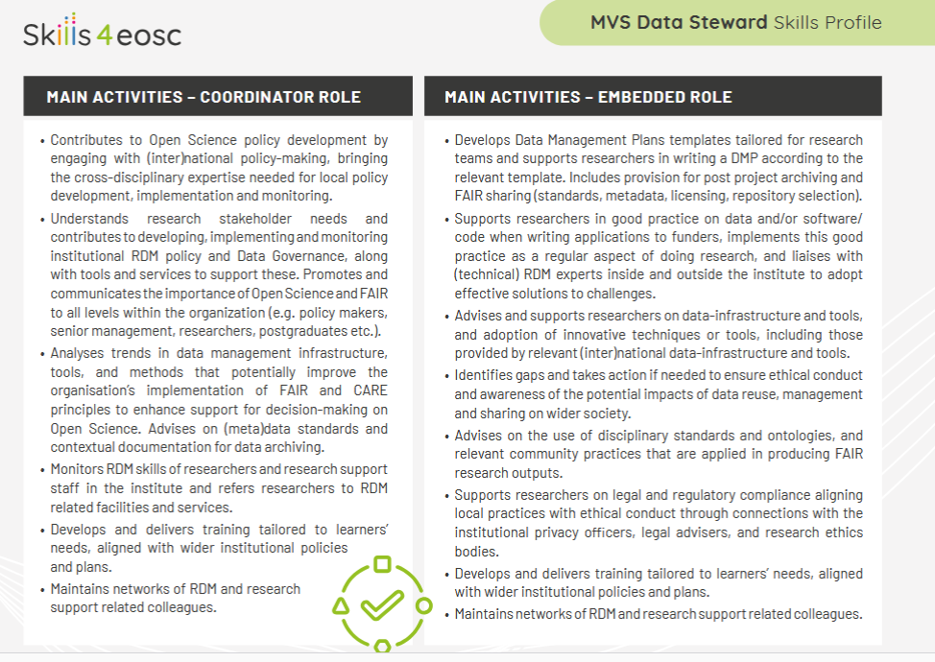

Slide 11
